Slide 1

Python Sequences

Slide 2
Contents
Creating List
Iterating List
List Operations
Creating Tuple
Iterating Tuple
Inserting into Tuple
Unpacking Sequence

Slide 3
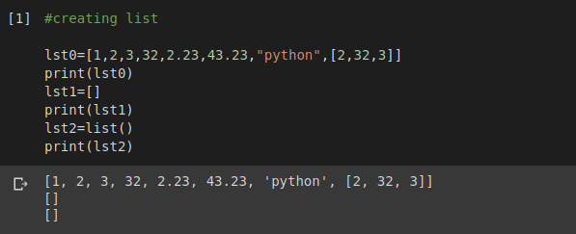
Creating List
Here lst1 and lst2 are empty lists

Slide 4
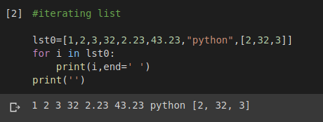
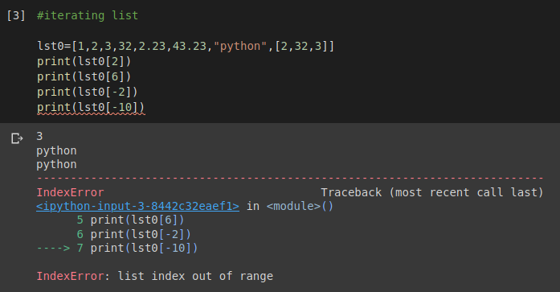
Iterating List
Iteration using loop and in operator
List can be iterated using negative indices but invalid index gives error.

Slide 5
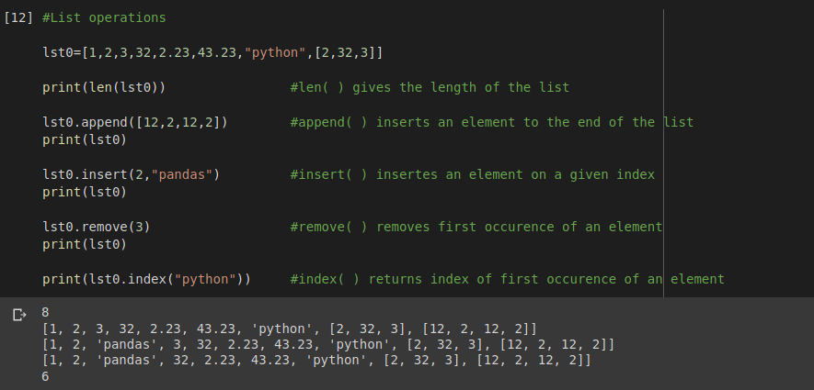
List Operations

Slide 6
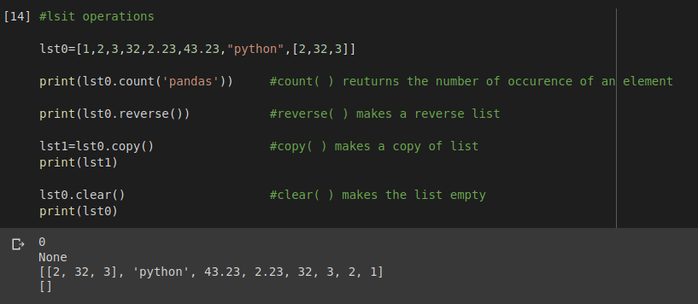
Continue...

Slide 7
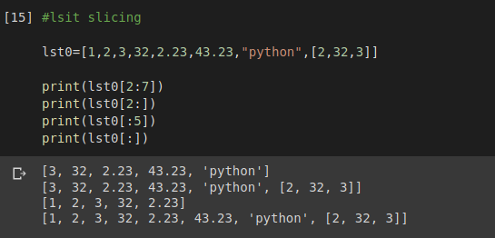
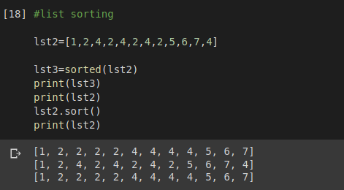
Continue...
List Slicing
List Sorting

Slide 8
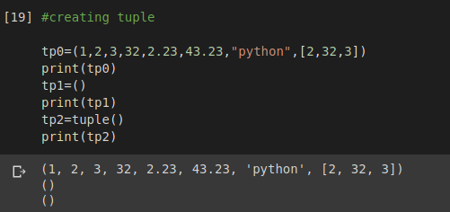
Creating Tuple
Here tp1 and tpt2 are empty tuples

Slide 9
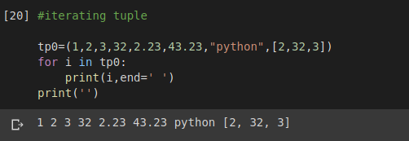
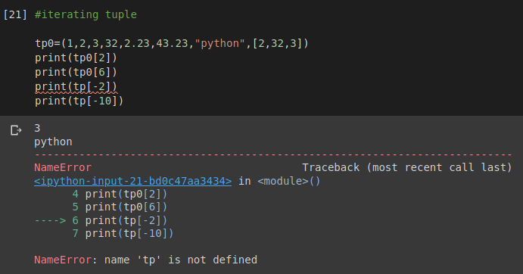
Iterating Tuple
Iteration using loop and in operator
Tuple can be iterated using negative indices but invalid index gives error.

Slide 10
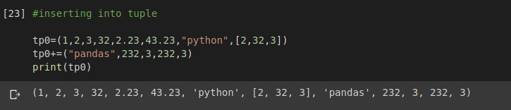
Inserting into Tuple

Slide 11
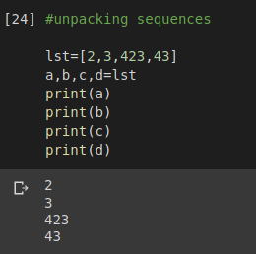
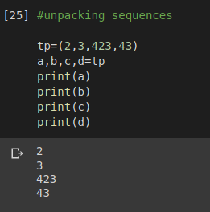
Unpacking Sequences

Slide 12
Thank You

